Slide 1
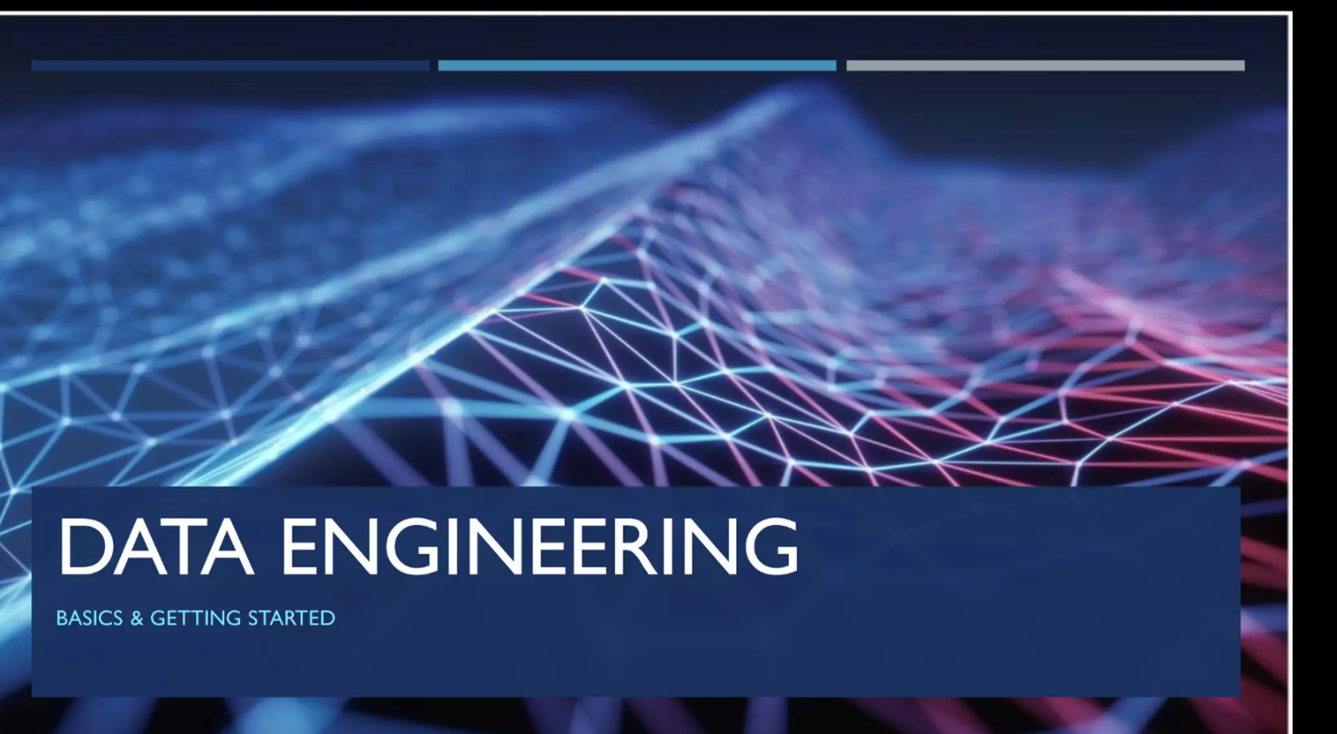

Slide 2


Slide 3
Data Engineering is the practice of designing and building systems to collect, store, and analyze large volumes of data. It's a critical field in the world of data science and analytics, as it provides the infrastructure and tools necessary to make data accessible and usable for various applications.

Slide 4
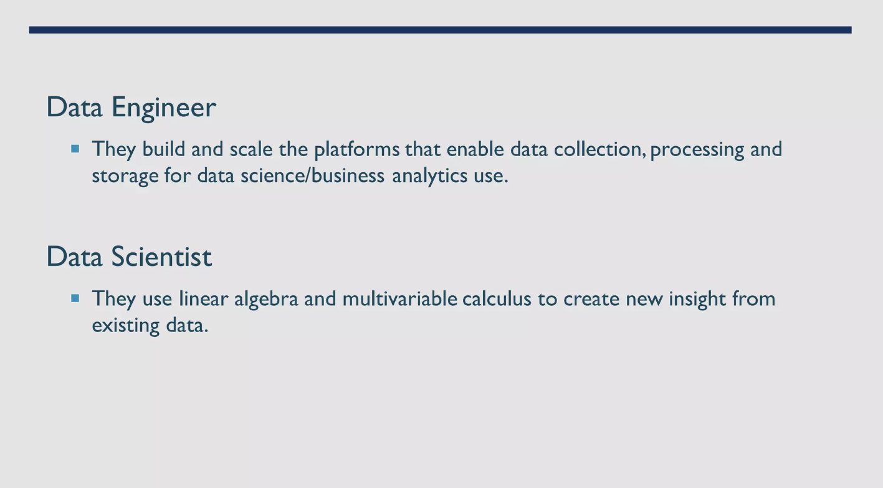

Slide 5
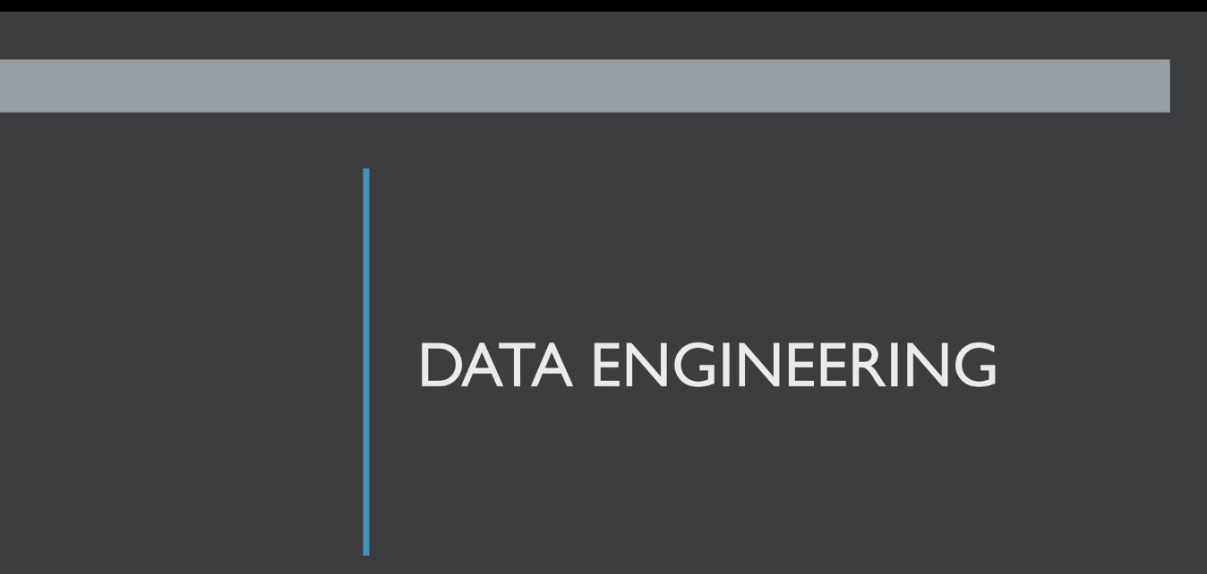

Slide 6
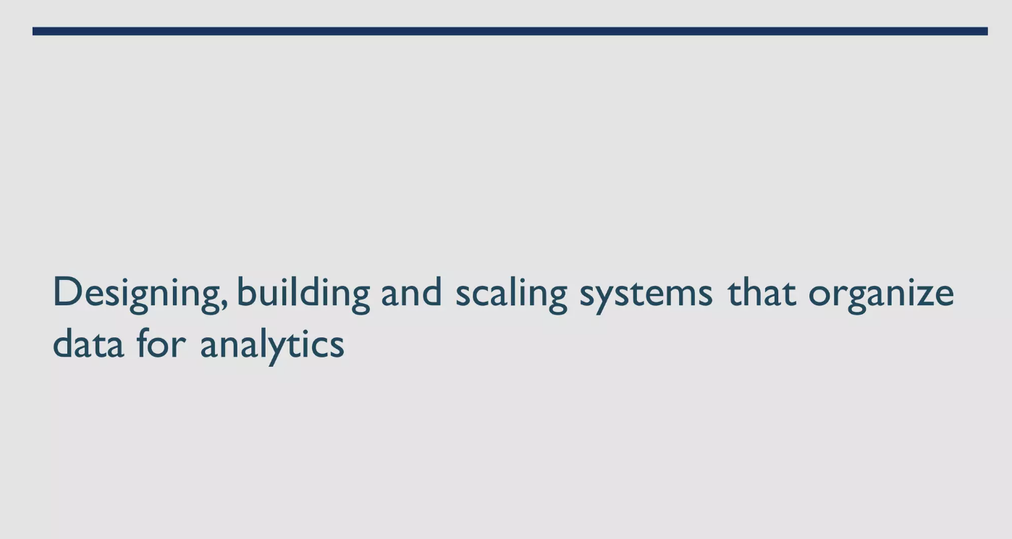

Slide 7
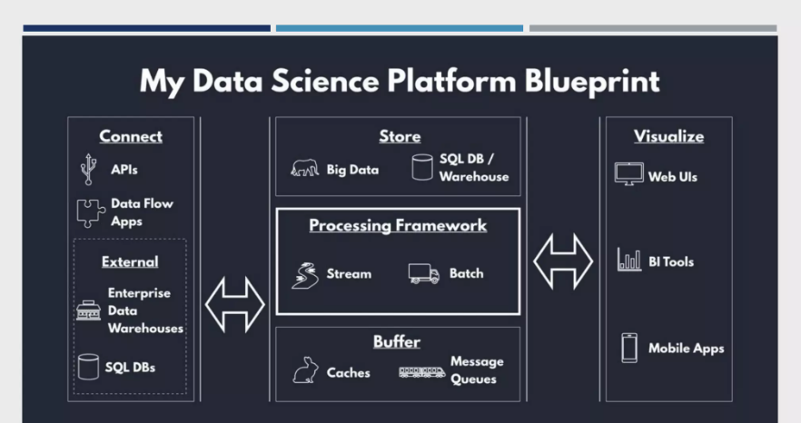

Slide 8
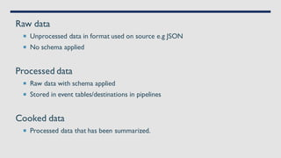

Slide 9
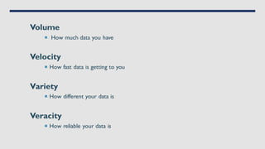

Slide 10
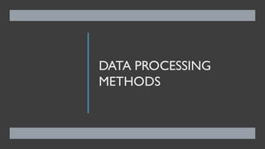

Slide 11
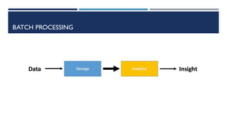

Slide 12
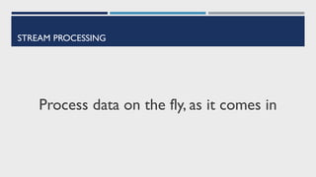

Slide 13


Slide 14
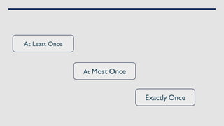

Slide 15
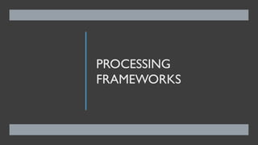

Slide 16
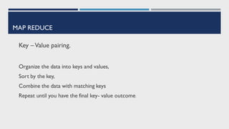

Slide 17
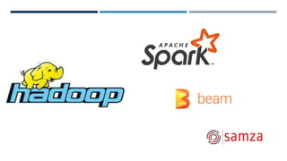

Slide 18
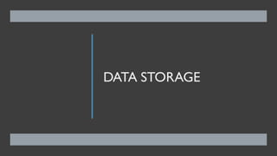

Slide 19
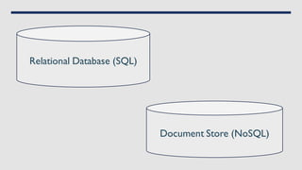

Slide 20
Stages of Data Engineering
1. Data Collection
Goal: Gather data from various sources.
Techniques: Extract data from databases, APIs, sensors, logs, files, etc.
Tools: SQL, Python, web scraping tools, APIs.
2. Data Ingestion
Goal: Load data into a storage system.
Techniques: Batch processing, real-time streaming.
Tools: ETL tools (e.g., Apache Nifi, Talend), data pipelines (e.g., Apache Kafka, AWS Kinesis).
3. Data Storage
Goal: Store data in a structured and accessible format.
Techniques: Use databases, data warehouses, and data lakes.
Tools: SQL databases (e.g., MySQL, PostgreSQL), NoSQL databases (e.g., MongoDB), data warehouses (e.g., Amazon Redshift, Google BigQuery), data lakes (e.g., Amazon S3, Azure Data Lake).

Slide 21
Stages of Data Engineering
4. Data Processing
Goal: Clean, transform, and enrich data.
Techniques: ETL (Extract, Transform, Load), data cleaning, data transformation.
Tools: Apache Spark, Apache Beam, AWS Glue, Python libraries (e.g., Pandas).
5. Data Integration
Goal: Combine data from different sources into a unified view.
Techniques: Data merging, joining, and blending.
Tools: SQL, data integration platforms (e.g., Informatica, MuleSoft).
6. Data Quality and Governance
Goal: Ensure data accuracy, consistency, and security.
Techniques: Data validation, data cleansing, data auditing.
Tools: Data governance tools (e.g., Collibra, Alation), validation frameworks.

Slide 22
Stages of Data Engineering
7. Data Analysis and Visualization
Goal: Analyze data and create visual representations for insights.
Techniques: Data querying, statistical analysis, machine learning, data visualization.
Tools: SQL, Python/R, BI tools (e.g., Tableau, Power BI), visualization libraries (e.g., Matplotlib, D3.js).
8. Data Monitoring and Maintenance
Goal: Continuously monitor and maintain data systems.
Techniques: Performance monitoring, system health checks, error handling.
Tools: Monitoring tools (e.g., Prometheus, Grafana), logging frameworks.
9. Data Security
Goal: Protect data from unauthorized access and breaches.
Techniques: Encryption, access control, security policies.
Tools: Security tools (e.g., AWS IAM, Azure Security Center), encryption protocols.

Slide 23
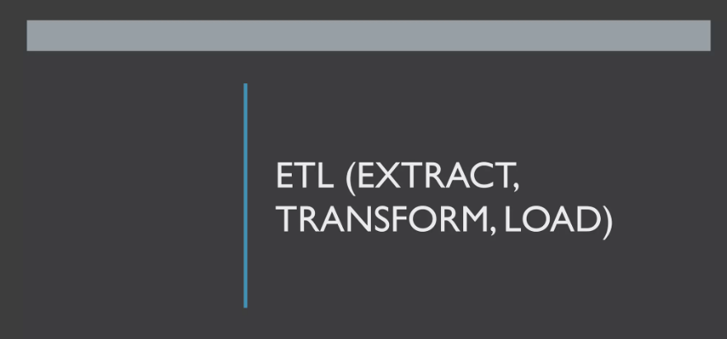

Slide 24
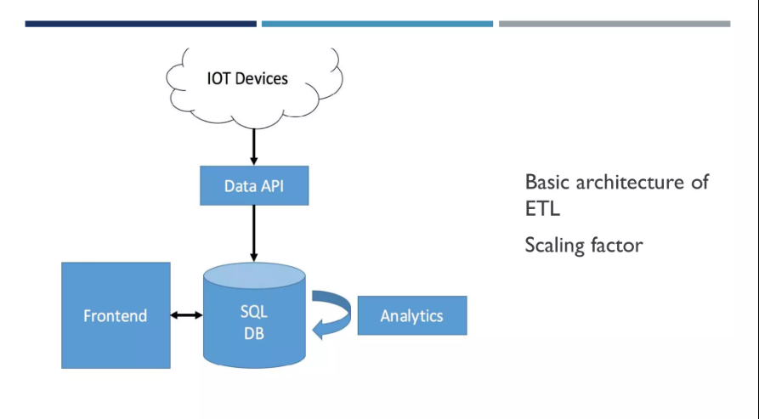

Slide 25
ETL Example
Imagine you are collecting sales data from different retail stores:
Extract: You gather sales data from different store databases and files.
Transform: You clean the data, remove duplicates, convert currencies, and calculate totals.
Load: You load the cleaned and transformed data into a centralized data warehouse for further analysis.

Slide 26
Data Engineering Challenges with Big Data
1. Volume
Challenge: Handling and storing massive amounts of data efficiently.
Solutions: Use distributed storage systems like HDFS, cloud storage services, and data partitioning strategies.
2. Velocity
Challenge: Managing the rapid influx of data in real-time or near real-time.
Solutions: Implement streaming data platforms such as Apache Kafka, Apache Flink, or AWS Kinesis.
3. Variety
Challenge: Dealing with diverse data types and sources, including structured, semi-structured, and unstructured data.
Solutions: Employ data integration tools and techniques, use data lakes to store diverse data types, and leverage schema-on-read techniques.

Slide 27
Data Engineering Challenges with Big Data
4. Veracity
Challenge: Ensuring data accuracy and reliability.
Solutions: Implement data validation, cleansing, and enrichment processes. Use robust data governance practices.
5. Scalability
Challenge: Scaling infrastructure to handle increasing data loads.
Solutions: Utilize cloud-based solutions that offer scalability, such as AWS, Azure, and Google Cloud Platform. Employ containerization and orchestration tools like Docker and Kubernetes.
6. Performance
Challenge: Maintaining high performance and low latency in data processing.
Solutions: Optimize data storage and retrieval strategies, use in-memory data processing frameworks like Apache Spark, and ensure efficient data indexing.

Slide 28
Data Engineering Challenges with Big Data
7. Security and Privacy
Challenge: Protecting sensitive data and ensuring compliance with regulations.
Solutions: Implement encryption, access controls, and data anonymization techniques.
8. Cost Management
Challenge: Managing costs associated with storing and processing large volumes of data.
Solutions: Use cost-effective storage solutions, optimize resource usage, and implement cost-monitoring tools to manage expenses.
9. Data Integration
Challenge: Integrating data from various sources and ensuring data consistency.
Solutions: Use ETL (Extract, Transform, Load) tools, data integration platforms, and data APIs to streamline integration processes.
10. Tool and Technology Selection
Challenge: Choosing the right tools and technologies for specific use cases.
Solutions: Stay updated with industry trends, evaluate tools based on requirements, and adopt a flexible tech stack that can evolve with changing needs.

